Slide 1
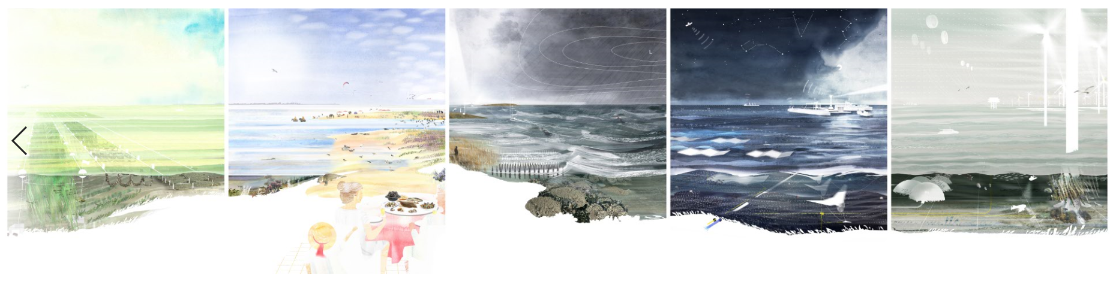
Blue Economy: a sea of opportunities
Compendium & Indicators Blue Economy (VLIZ)

Slide 2
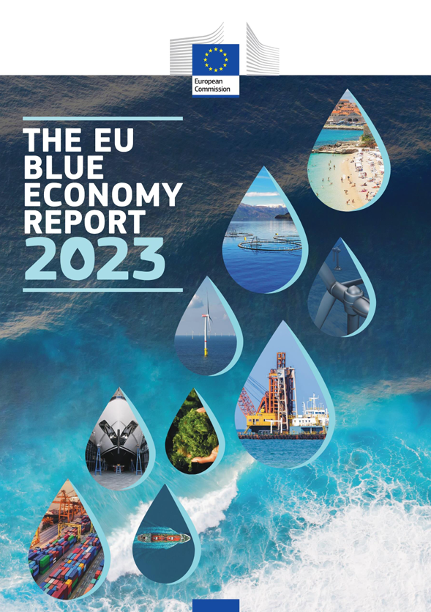
Turnover of €523 billion in 2020
3,34 million people employed in 2020
decrease of 26% vs 2019
coastal tourism impacted by COVID pandemic
jobs in offshore wind energy increased X 30 in 11 years
Substantial financial support
BlueInvest Fund (2020): equity funding programme of €300 million
InvestEU Blue Economy Fund (2022) will result in €1.5 billion of riskfinancing

Slide 3



The Blue Economy: a strong pillar in Flanders
Scoop
5.2% of the Flemish GDP
Direct Impact
Turnover |  | Employment |  | Added value
Chemistry & life sciences | € 46B | Blue Economy | 85,000 FTE | Blue Economy | € 8.2B
Food | € 41B | Chemistry | 68,000 FTE | Chemistry | € 5.5B
Blue Economy | € 40B | Food | 51,000 FTE | Food | € 1.9B
Notes:
Doelstelling: De economische en maatschappelijke relevantie van de blauwe economie in Vlaanderen in kaart brengen.
Definitie blauwe economie: “Alle economische activiteiten verbonden aan oceanen, zeeën en kusten”
Aanpak
Aanpak:
1) De economische impact wordt berekend op drie systeemniveau’s: directe impact + indirecte impact (impact bij toeleveranciers) + afgeleide impact (impact op economie ten gevolge van bijkomende inkomensvorming door blauwe economie direct en indirect (bij toeleveranciers)
2) De maatschappelijke impact wordt in kaart gebracht aan de hand van systematisch analyseschema via documentonderzoek, online websurvey en gevalstudies
De gevalstudies: Echodrone, Edulis, Coastbusters en Digitale toepassingen voor onderhoud offshore windmolenparken

Slide 4
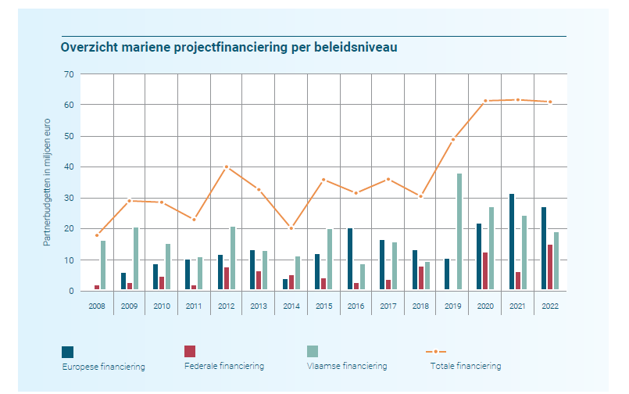
Impact of the Blue Cluster

Slide 5




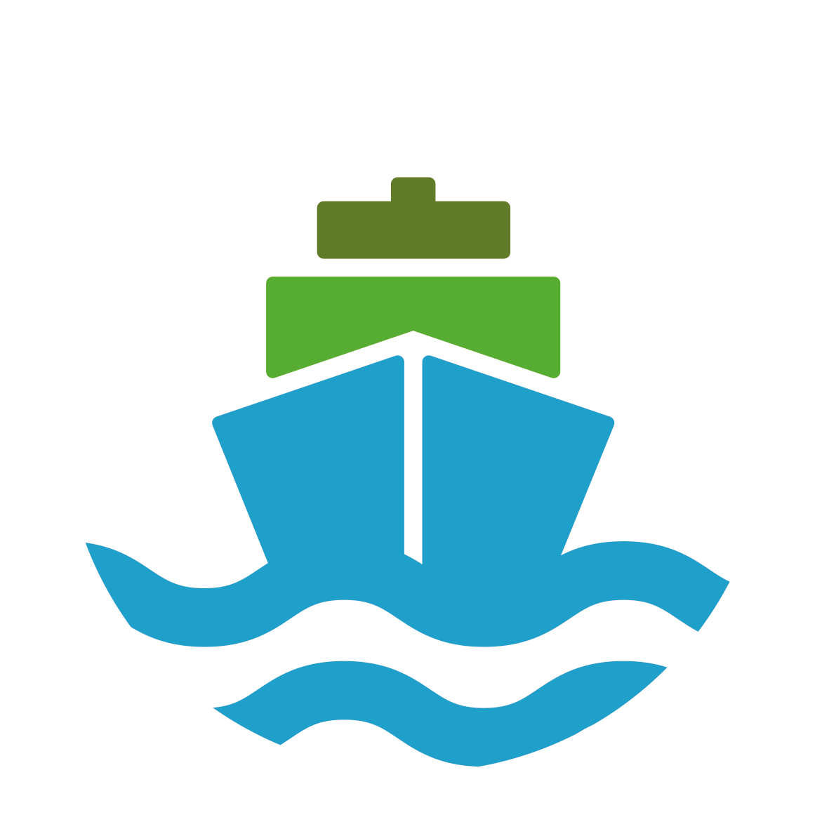



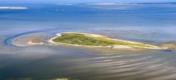
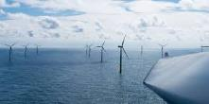
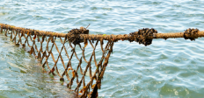
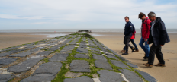
Innovation areas
OVERARCHING CONCEPT
ECOSYSTEM APPROACH
OVERARCHING CONCEPT
SMART SEA
COASTAL PROTECTION
RENEWABLE ENERGY
MARITIME CONNECTION
SUSTAINABLE SEAFOOD
and MARINE BIOTECHNOLOGY
BLUE
TOURISM
OCEAN HEALTH

Slide 6
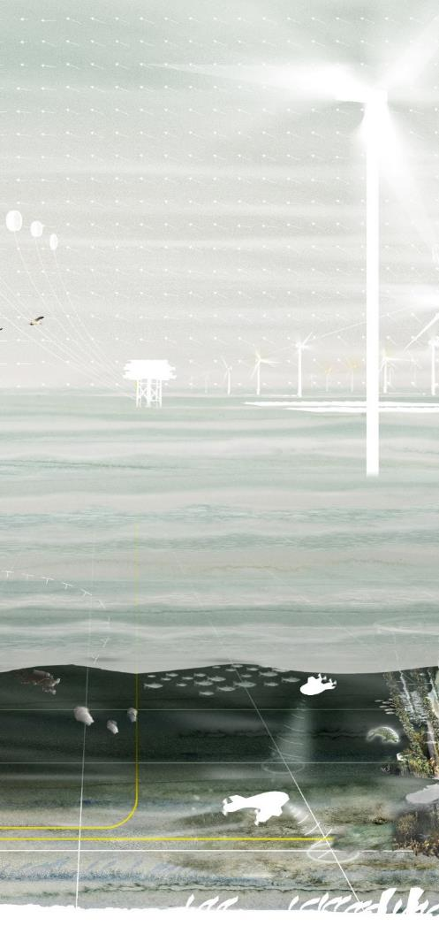

Members and partners
knowledge institutions
participation in European projects
14
11
7
other
194 companies
46
Current collaboration initiatives between at least 3 companies
103
unique companies involved in collaboration initiatives
51% SMEs

Slide 7
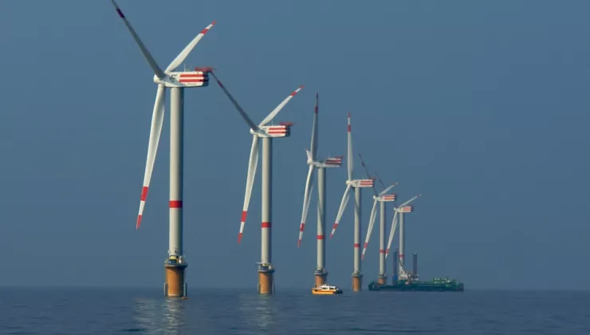
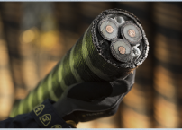

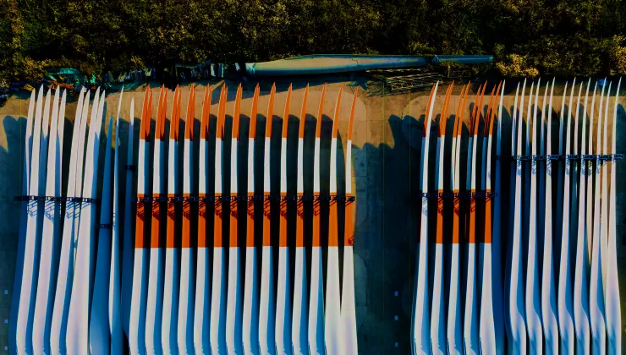
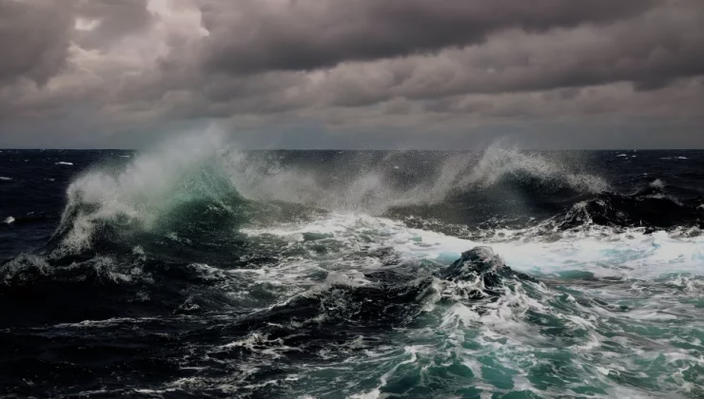
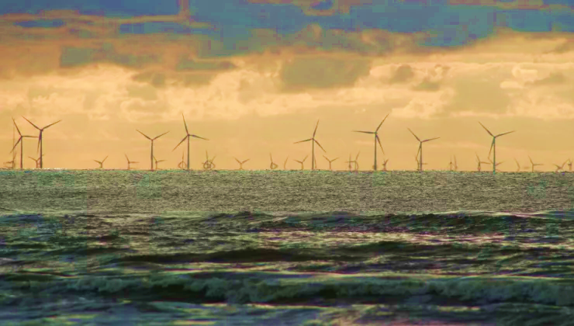
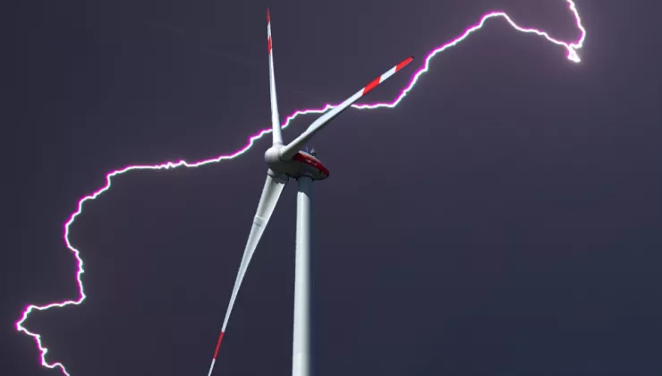
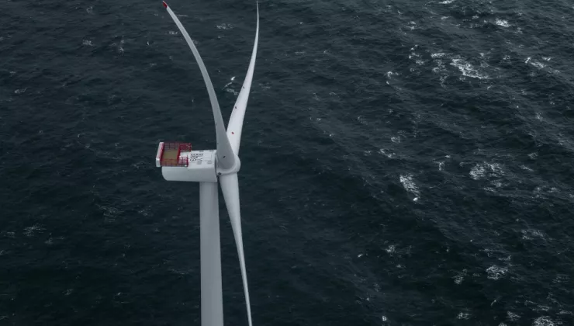

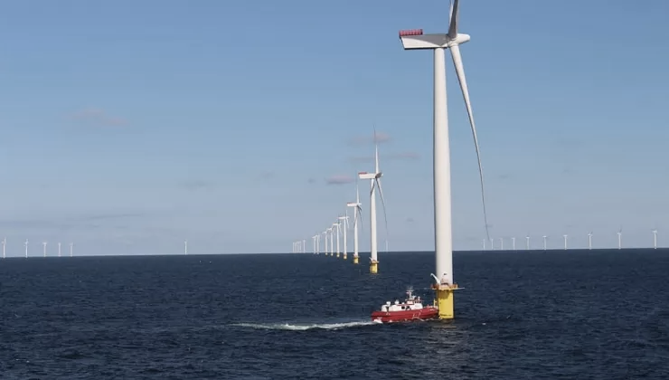
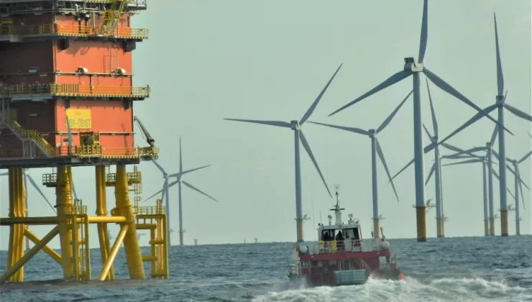
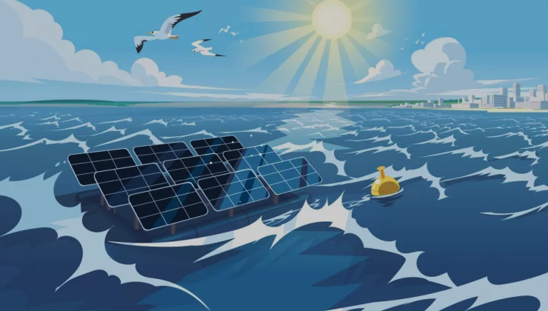
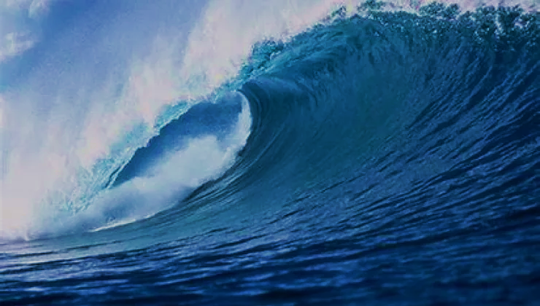
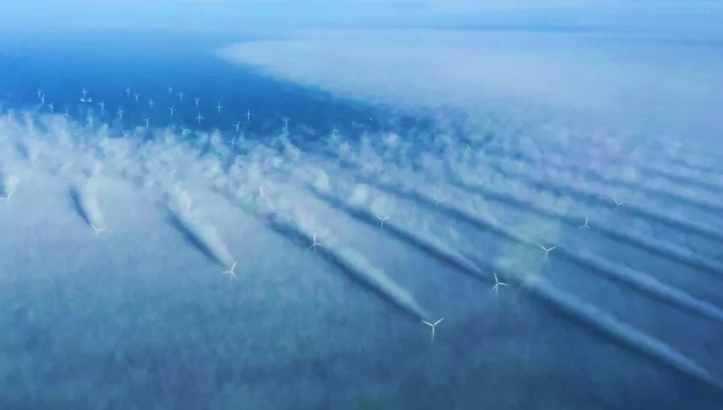
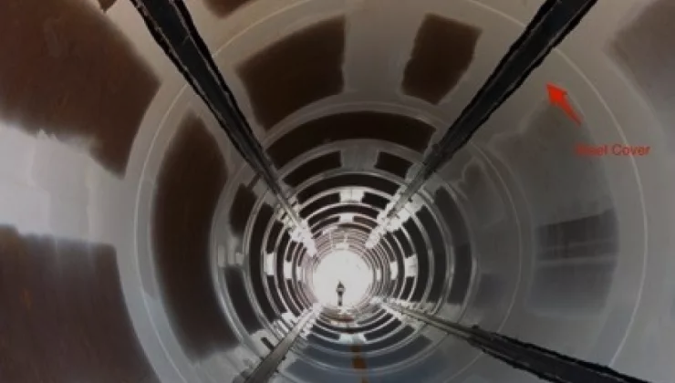
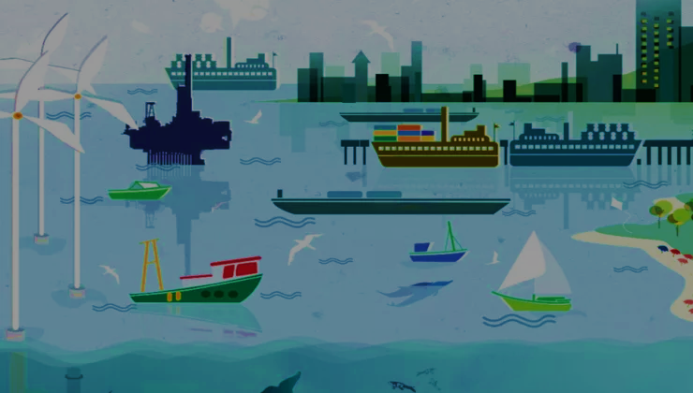
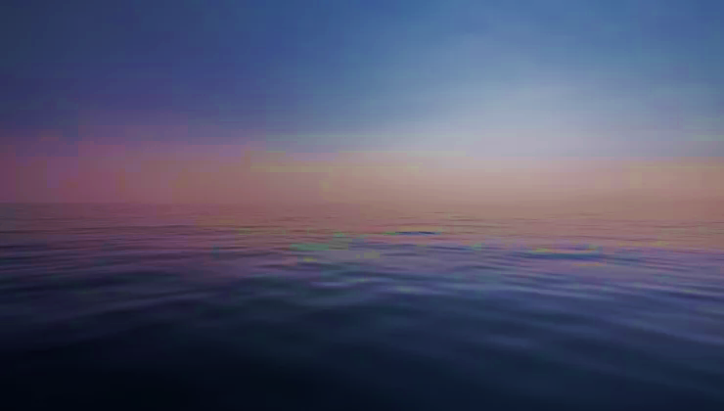
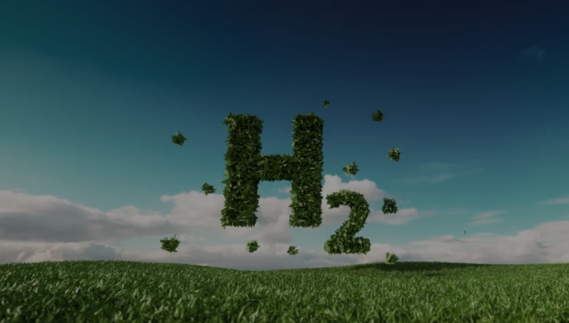

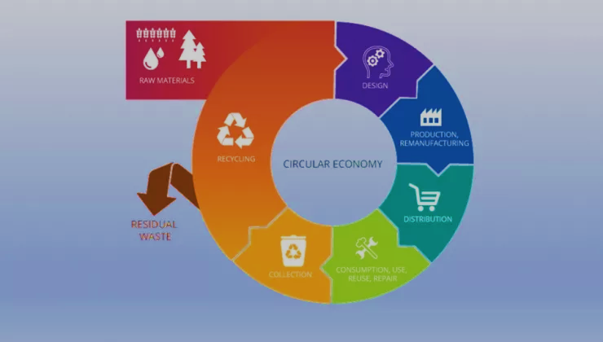
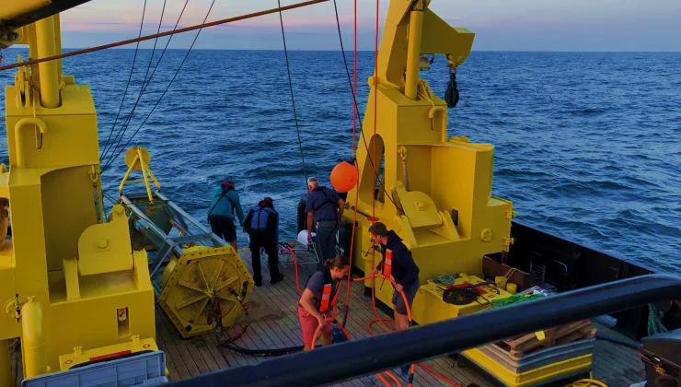
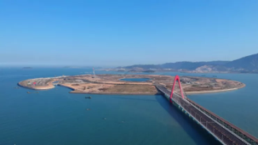
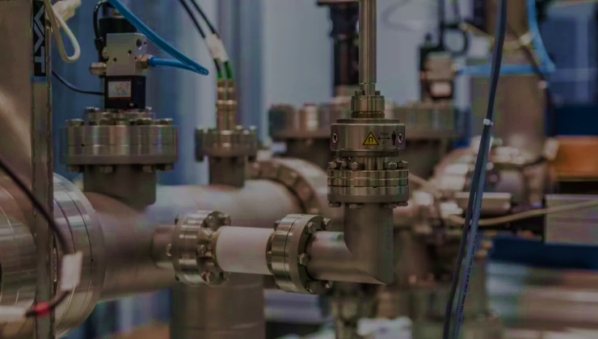
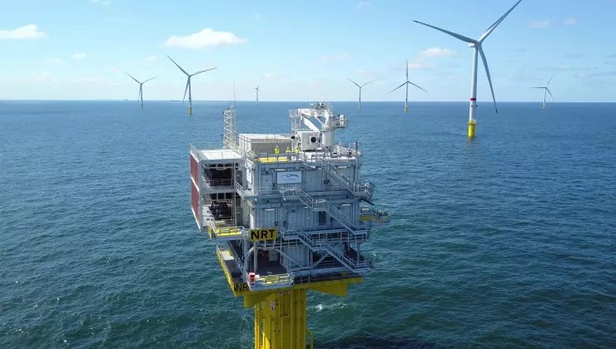




Roadmap hernieuwbare energie
Monitoring en levensduurverlenging
Schaarste
Internationalisatie
Smart-GBF
BOPTIC
T-Shore
Ready4Decom
ELBE +
Inn2Power
RAINBOW
Supersized 4.0
Services & logistiek
Nieuwe Technologieën
SMARAGD
OPAL
MPVAqua
BlueERA
Digital Twin
Meervoudig ruimtegebruik
Energie conversie
Cloud4wake
SOIL-TWIN
eMSP-NBSR
D4PV@Sea
H2-MHYTIC
INTENSSE-H2
Clay Tectonics
CORDOBA
CTO
Mfiland
Sweet H2(O)

Slide 8


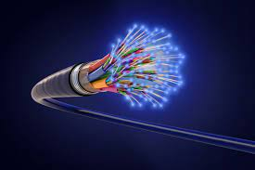

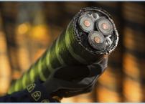



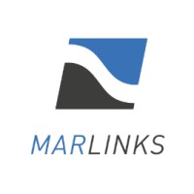






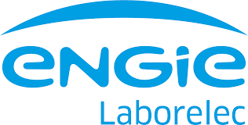

BOPTIC
Monitoring of offshore power cables and foundations by Distributed Fiber Optic Sensing
55% van alle verzekeringsclaims in offshore windparken wordt veroorzaakt door schade aan de kabels en aansluitingen, dit resulteert in een zeer hoge operationele kost en dus ook een hoge levelised cost of energy (LOE)
Optische monitoringstechnologieën ontwikkelen en implementeren om slimme kabels en funderingen te voorzien voor offshore windparken aan de hand van optische verzeltechnologieën. Op deze manier kunnen de OPEX-kosten van de Balance Of Plant (BOP) verminderd worden.
1. Basis laboratorium experimenten
2. Modelleren
4. Detectie van elektrische storingen en O&M
3. Toepassingsmethoden en dynamische testen
5. In-field data collectie
Juli 2019
Juni 2022

Slide 9

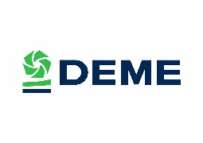
















































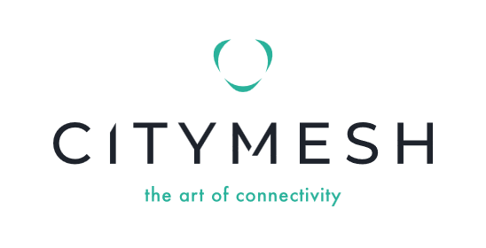





BELGIAN VALUE CHAIN IN OFFSHORE WIND
9
PROJECT DEVELOPMENT AND SITING
DESIGN AND MANUFACTURE OF COMPONENTS
ASSEMBLY AND INSTALLATION
FOUNDATIONS
OPERATION AND MAINTENANCE
GRID CONNECTION
SUPPORT SERVICES AND AUXILIARY EQUIPMENT
R&D ENTITIES
TEST SITES
Note: This graph is for illustrative purposes only and does not include the logos of all the Belgian companies participating in the offshore wind value chain
Notes:
Because of the early Belgian domestic development of offshore wind, a lot of local know-how has been created. Belgian companies are active in:
Project development and site investigations: we share the experiences of our operators with extensive know-how in resource assessment, feasibility and front-end engineering studies, and environmental site assessments.
In the design and manufacturing of components, we have companies active in connectors, gearboxes and hydraulic systems.
We have successful companies in the manufacturing of TPs and jacket foundations, high voltage equipment, offshore transformer stations and integrated solutions for grid connection.
In installation we have world leaders Jan De Nul and DEME represented here.
In O&M we offer inspection and repair services, corrosion protection, remote control and monitoring systems.
Finally, a large group of businesses are active in support services like asset monitoring, development of sensors, underwater services, communication systems, survey, surveillance, etc.
I want to emphasize that it was not possible to include the logos of all Belgian businesses and R&D institutes active in offshore wind on this slide.

Slide 10
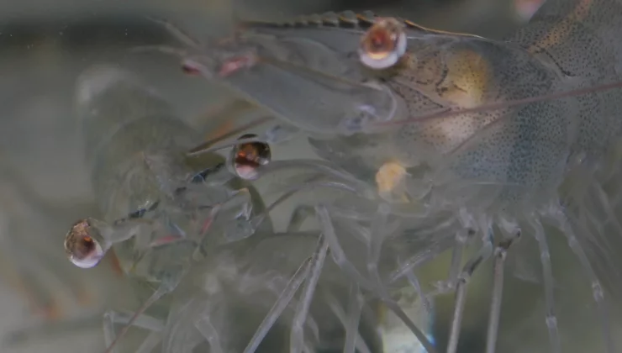
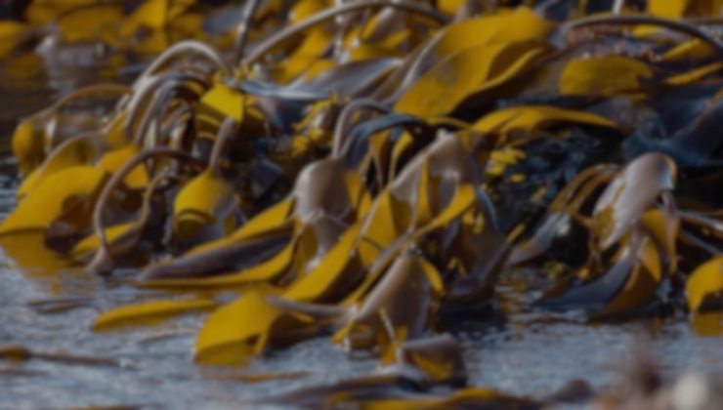
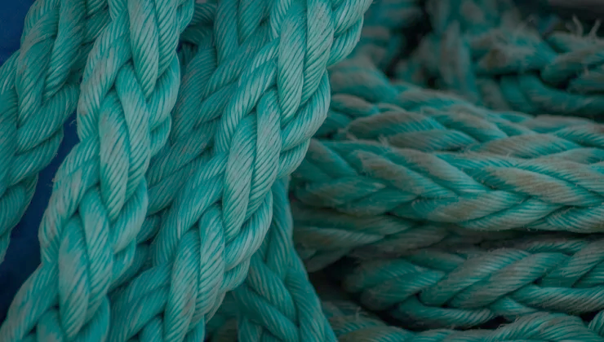

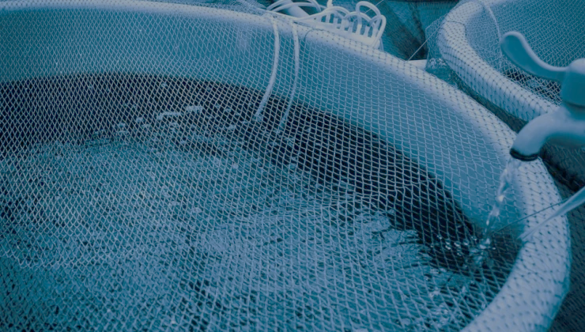
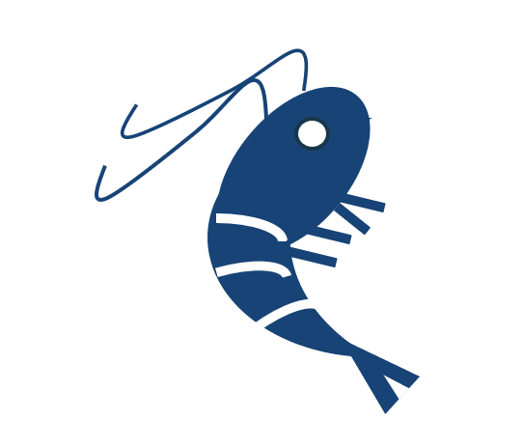


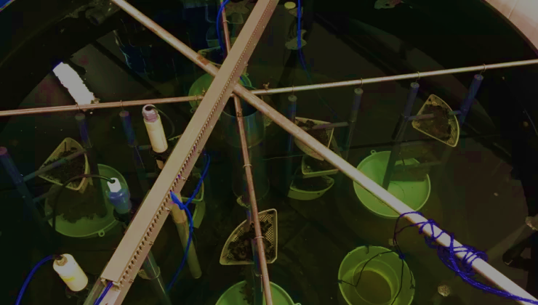

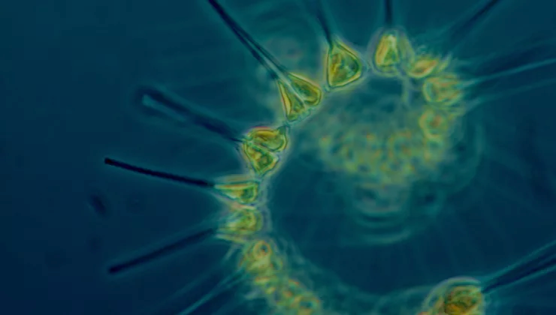
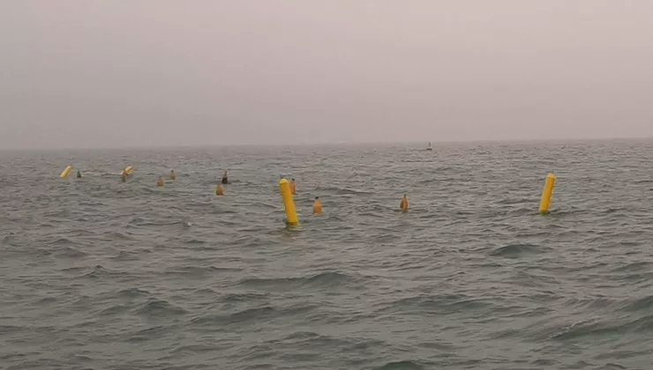
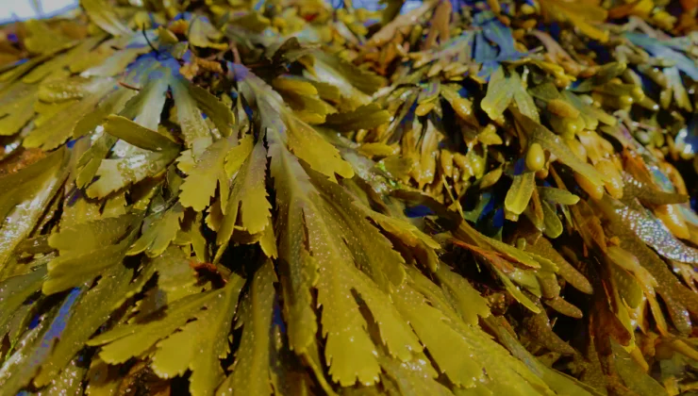
Roadmap Sustainable Seafood and Marine Biotechnology
Innovation in production system
Bio(-tech) products
C-Shrimp
SiteSea
FResCo
BlueBio
Clusters
BlueMarine³.com
Multi-use
Bio-prospecting
D4PV@Sea
PERSUADE
EnzyMares
PROBIO
SYMAPA
MARCOS

Slide 11


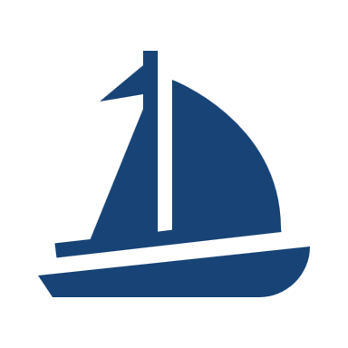









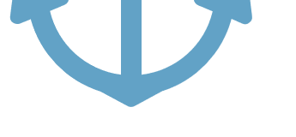
Bio(-tech) Products
FresCo
BlueBioClusters
Develops new, non-toxic and bio-based additives for coatings to prevent biofouling for land and marine applications
Supporting European regions, businesses and citizens in the transition to a sustainable blue bioeconomy by valorising ecosystem services
May
2022
April
2024
August
2022
July
2025

Slide 12

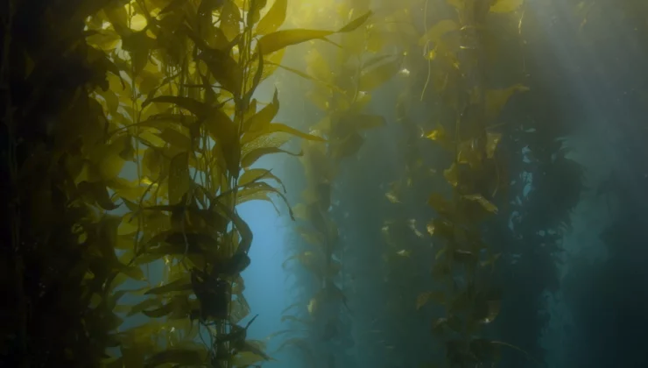
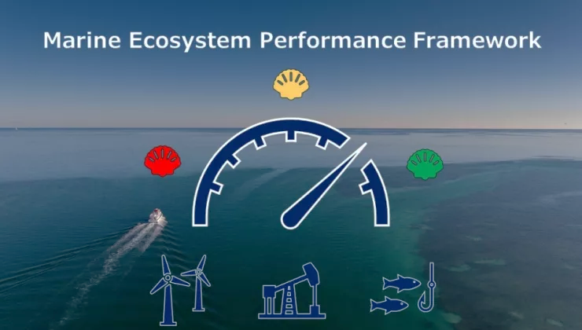


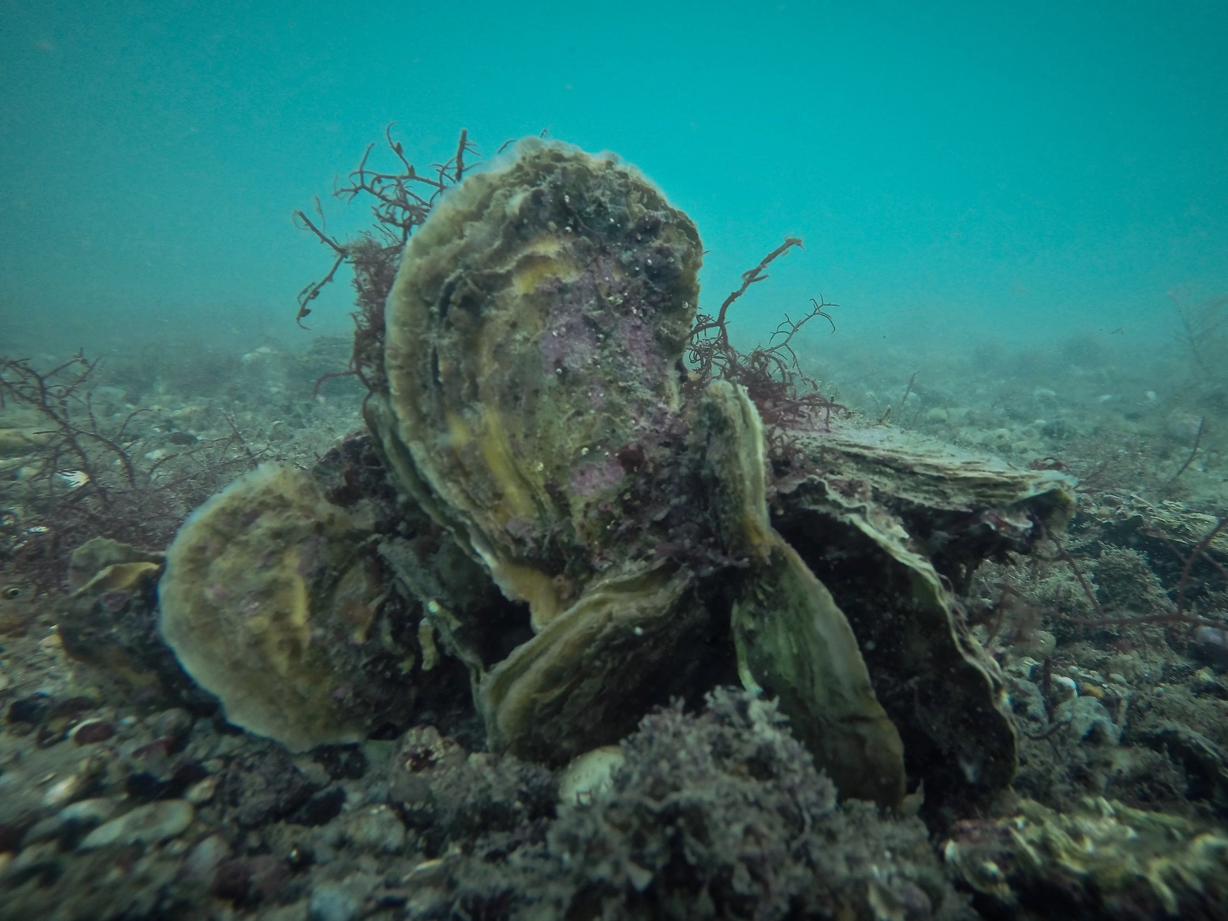


Roadmap ecosysteembenadering
Ecosysteembenadering:
In de blauwe economie worden economische activiteiten aangedreven door de ecosysteemdiensten van het mariene milieu. Daarom passen we de zogenaamde ecosysteembenadering toe, waarbij we rekening houden met de fysieke en biologische omgeving waarin we werken. De ecosysteembenadering van de Blauwe Cluster omvat alle ecosysteemaspecten in de ontwikkeling van economische activiteiten, opdat de levering van waardevolle ecosysteemdiensten wordt behouden.
Ecosysteem diensten
SUMES
WABESCO
MEsP
BlueBio
Clusters
Carbon emissions
Nature inclusive design
Reefcovery
North-C- Neutral²
Blue Mission Banos

Slide 13





Slide 14




Nature inspired coastal protection
Notes:
Pilot tussen Oostende en Bredene
Onderzoeksdijk Raverszijde
Grasdijk Westende
Coastbusters rif

Slide 15


Slide 16



Capacity Belgian North Sea:
2,3 GW > 6 GW by 2030
Floating solar: first proto-types

Slide 17








Slide 18


Slide 19




Slide 20





Slide 21


Seafar – remote control center
First remote controlled inland ship

Slide 22

The Reef: XR training

Slide 23





We are Blue Cluster

